Slide 1
Trigonometry
Compound Angles, Sums & Products

Slide 2
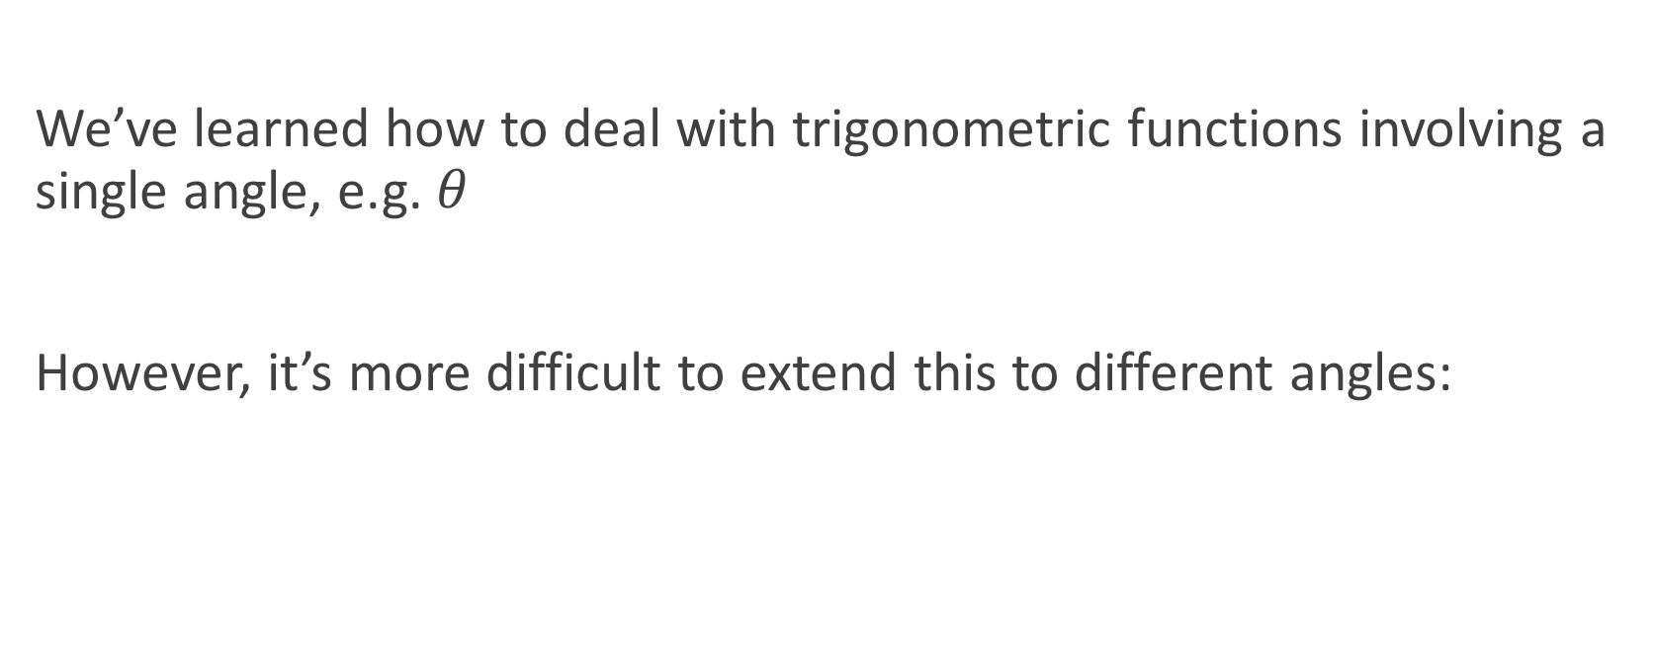
Compound Angles
We’ve learned how to deal with trigonometric functions involving a single angle, e.g. $θ$
However, it’s more difficult to extend this to different angles:
$$\sin\left(A\right)+\sin\left(B\right)≠sin⁡(A+B)$$

Slide 3
Double Angles
The simplest type of compound angle is the double angle.
These are just a special case, but have a dedicated section on the formula sheet.

Slide 4

Double Angles
$\sin\left(2A\right)=2\sin{A}\cos{A}$
$\tan\left(2A\right)=\frac{2\tan{A}}{1 −\tan^{2}{A}}$
$\cos{2A}=\cos^{2}{A}−\sin^{2}{A}$
$\cos{2A}=2\cos^{2}{A} −1$
$\cos{2A}=1 − 2\sin^{2}{A}$
NOT +

Slide 5
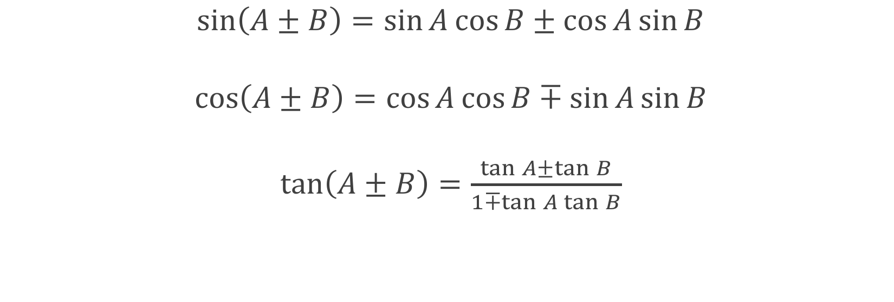
Compound Angles
$\sin\left(A±B\right)=\sin{A}\cos{B}±\cos{A}\sin{B}$
$\cos\left(A±B\right)=\cos{A}\cos{B}∓\sin{A}\sin{B}$
$\tan\left(A±B\right)=\frac{\tan{A}±\tan{B}}{1∓\tan{A}\tan{B}}$
Use the opposite sign

Slide 6

Examples
$\sin\left(A+90°\right)=\sin\left(A\right)\cos\left(90°\right)+\cos\left(A\right)\sin\left(90°\right)$
$\sin\left(A+90°\right)=\cos\left(A\right)$
$\frac{sin⁡(2A)}{2sin⁡(A)}=\frac{2\sin\left(A\right)cos⁡(A)}{2sin⁡(A)}=cos⁡(A)$

Slide 7
Extra for Experts
Prove the Compound Angle rules:
B
A

Slide 8
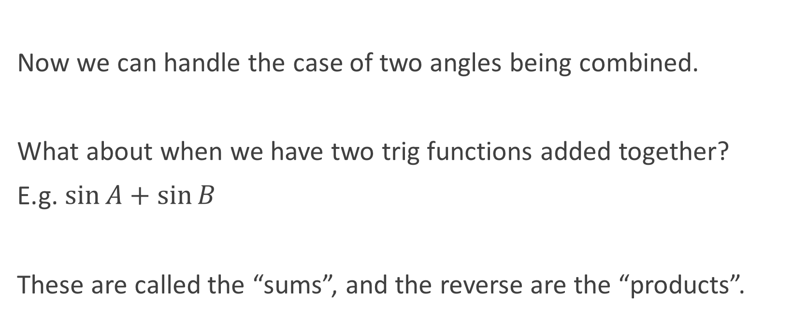
Sums & Products
Now we can handle the case of two angles being combined.
What about when we have two trig functions added together?
E.g. $\sin{A}+sin⁡B$
These are called the “sums”, and the reverse are the “products”.

Slide 9
Sums & Products
I’m not going to go through all the formulae, they are on the formula sheet.
One thing: don’t miss the negative for the final Sum formula!

Slide 10
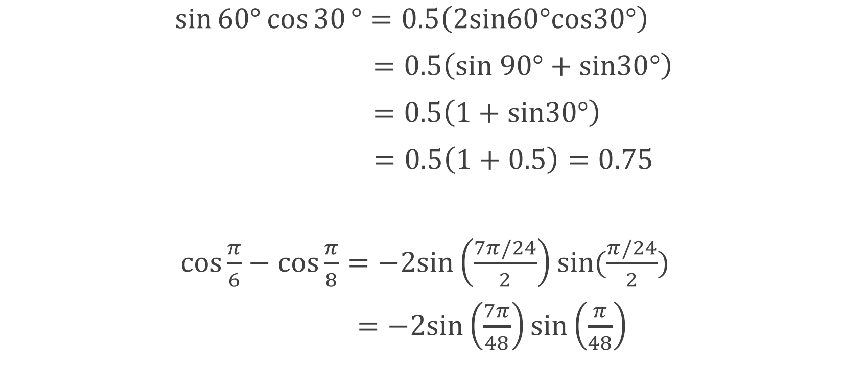
Examples
$\sin{60°}\cos{30}°=0.5\left(2sin60°cos30°\right)$
$\sin{60°}\cos{30}°=0.5\left(sin 90°+sin30°\right)$
$\sin{60°}\cos{30}°=0.5\left(1+sin30°\right)$
$\sin{60°}\cos{30}°=0.5\left(1+0.5\right)=0.75$
$\cos{\frac{π}{6}}−\cos{\frac{π}{8}}=−2sin\left(\frac{7π/24}{2}\right)sin(\frac{π/24}{2})$
$\cos{\frac{π}{6}}−\cos{\frac{π}{8}}=−2sin\left(\frac{7π}{48}\right)sin\left(\frac{π}{48}\right)$

Slide 11
Do Now
Any Questions?
Delta Workbook
Exercises 34.3-34.8, 34.9-34.10
Workbook
Pages 83-97

Slide 12

This work is licensed under a Creative Commons Attribution-NonCommercial-ShareAlike 4.0 International License.
Aaron Stockdill
2016

